Slide 1

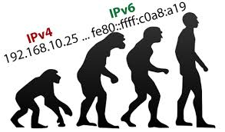
BHAGAVAN MAHAVIR COLLEGE OF COMPUTER APPLICATION
SEMINAR PRESENTATION
ON
(Internet Protocol Version 6)
(IPV6)
SUBMITTED BY: GUIDED BY :
Yadav Nirmala(ROLL NO:115) MISS. JAIMINI PATEl

Slide 2

Index
Introduction
What is ipv6
Why we need ipv6
Features of ipv6
Types of ipv6 address
Ipv6 addressing
Advantages
Disadvantages
Conclusion
10. references

Slide 3
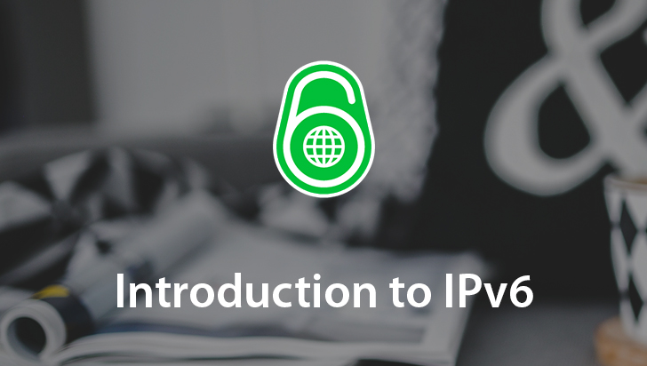
Introduction
Ipv6 or IP version is the next generation internet protocol which will eventually replace the current protocol ipv4.
Ipv6 has a number of improvements and simplification when compared to ipv4.
The primary difference is that ipv6 uses 128 bit addresses as compared to the 32 bit address used with ipv4.

Slide 4
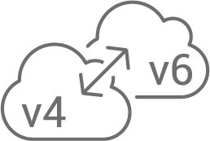
What is ipv6
Ipv6 or internet protocol version 6 is an address system not unlike address used to identify homes and buildings. addresses
Ipv4 and ipv6 protocols define how associated with networked (internet or otherwise digital devices are created
I will also provide features such as improved routing traffic and better security.

Slide 5
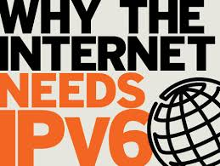
Why we need ipv6
The internet has experienced a increase of devices accessing the inter net.
Because of this increase ipv4 addresses are running out.
The solution is for ipv6 to accommodate this increased demand by providing a much large address space,
Along address space,
Along with improved traffic routing and better security.

Slide 6
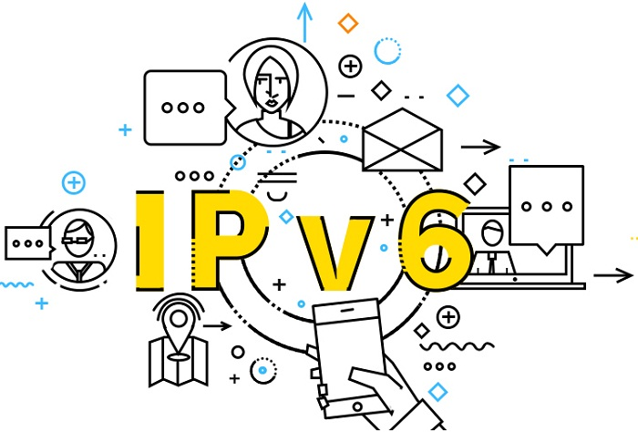
Features of ipv6
Large address space
Aggregation based address hierarchy
- efficient backbone routing
Efficient and extensible IP datagram
128bits for IP addressing
Address format hexadecimal notation
- one IP address per proton on earth
Stateless address autoconfiguration
Security (IPsec mandatory)

Slide 7
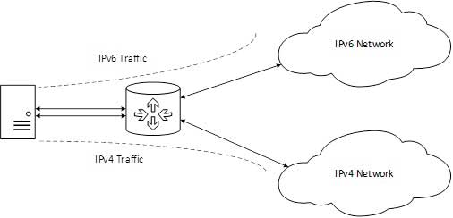
Type of ipv6 address
Unicast of IPV6 Addresses
The packet sent to a unicast address must be delivered to the specific computer.
Multicast Addresses
The packet sent to a multicast address must be delivered to the each member of the group.
Anycast Addresses
the packet sent to a anycast address is delivered to only one of the member of the group the nearest one.

Slide 8
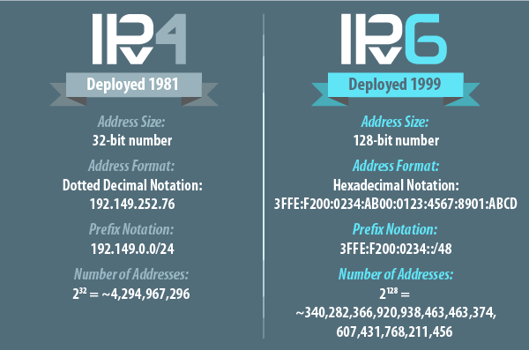
IPV6 Addressing
The primary change from IPV4 to IPV6 is the length of network addresses.
128 bit vs. 32 bit
Narration
IPV6 addresses are normally written as eight group of four hexadecimal digits.

Slide 9
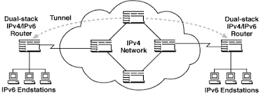
Advantage of IPV6
Increased Capacity: of address space—resources are efficiently allocated to accommodate additional web addresses.
Efficient Routing: allows for easy aggregation of prefixes assigned to IP networks.
Efficient Data Flow: enables large data packets to be sent simultaneously helping to conserve bandwidth.
Security: is improved due in part to improved authentication methods built into network firewalls.

Slide 10
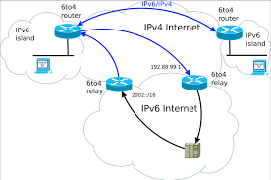
Disadvantage of IPV6
Conversion: IPv4 is still widely used and the world is slow to convert to IPv6.
Communication: IPv4 and IPv6 machines cannot communicate directly to each other, in the very rare circumstance that they would need to.
Transition: The process of making the switch to IPv6 from IPv4 is slow and tedious.
Readability: Understanding IPv6 subnetting can be difficult on its own, let alone trying to remember/memorize your IPv6 address

Slide 11
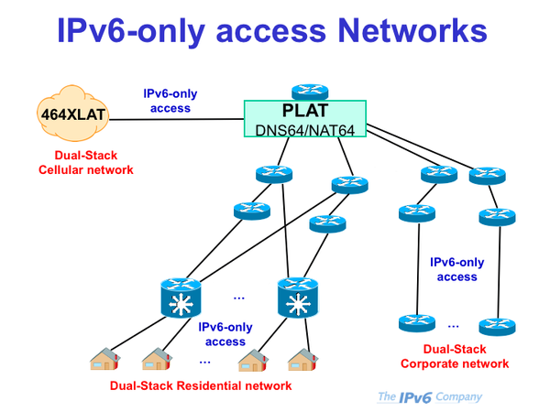
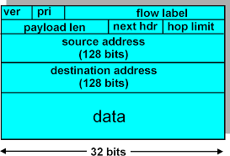

Slide 12
Conclusion
Today internet is getting the title of global network.
Thus we need more address space than we have in IPV4 protocol.
The shortage of address problem leads to the development of a new protocol(IPV6).
IPV6 has much large IP addresses available, it has 2^128 address space, which is sufficient for a longer time for various application.
This will basically support mobile systems, simplified header, operation security etc.

Slide 13
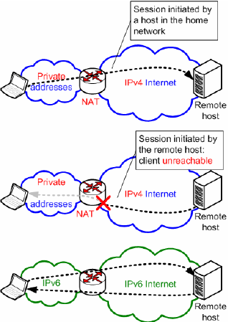

Slide 14
References
www.slideshare
search short definition
Online ipv6 pdf file

Slide 15

Thank you

